Slide 1

C++ Ρroject Rock, Ρaρer, Scissors
Alexander Klooss, Hugo Mauroy, Alexandre Roisin

Slide 2
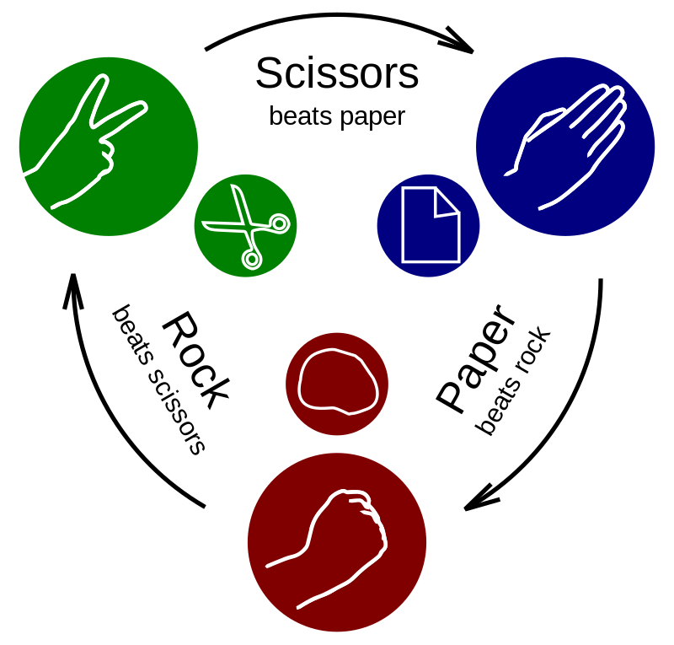

Slide 3

Functionality (How it works)

Slide 4
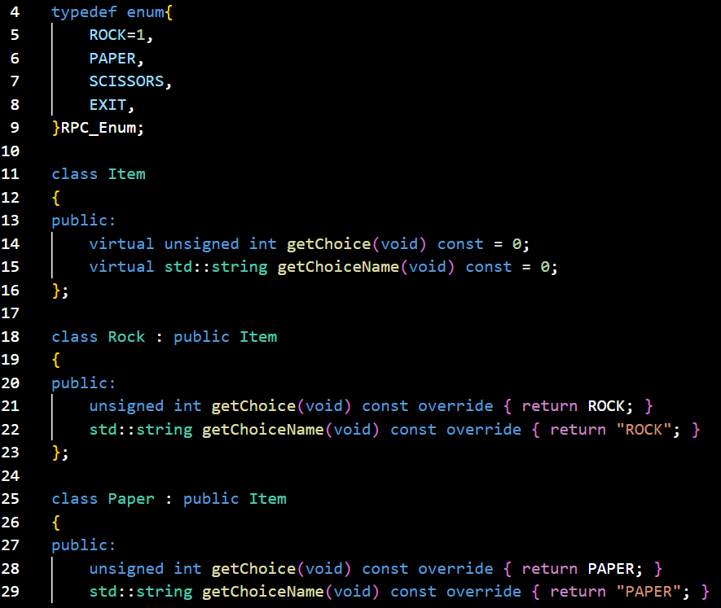
Class: Item
Derived classes: Rock, Paper and Scissors

Slide 5
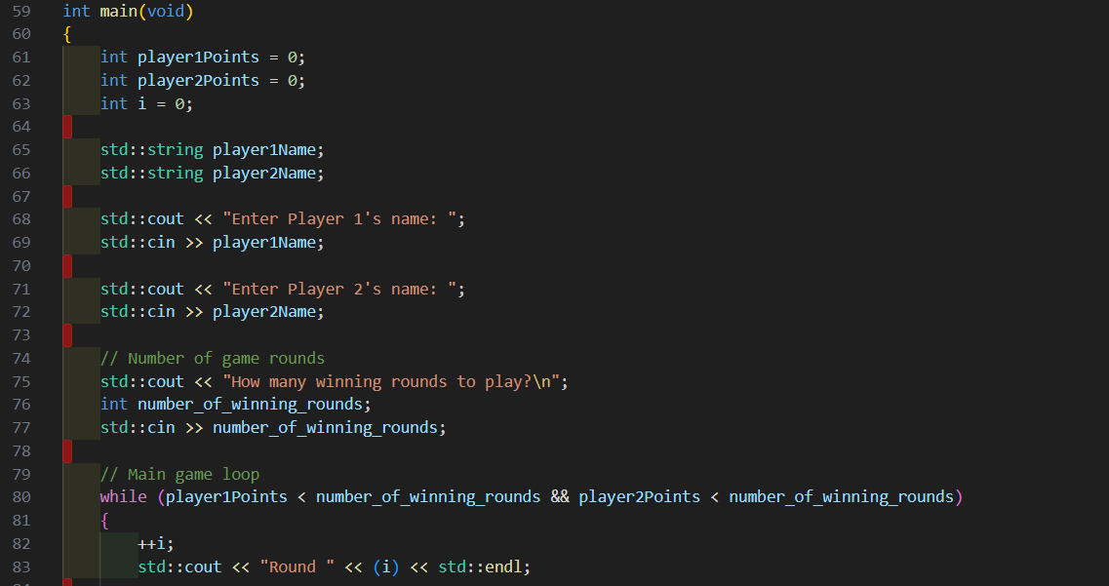
Main: get player names and number of rounds

Slide 6
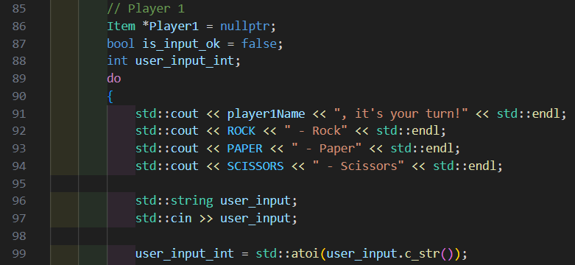
Ρlayers choice
Atoi converts from „string“ to „int“

Slide 7
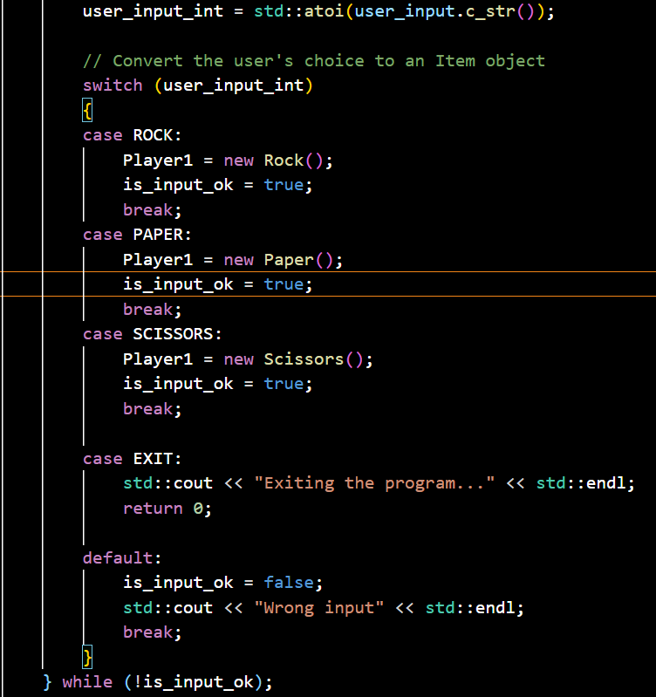
Choose Item
Depending on Input, creating an object of type Rock, Scissors or Paper

Slide 8
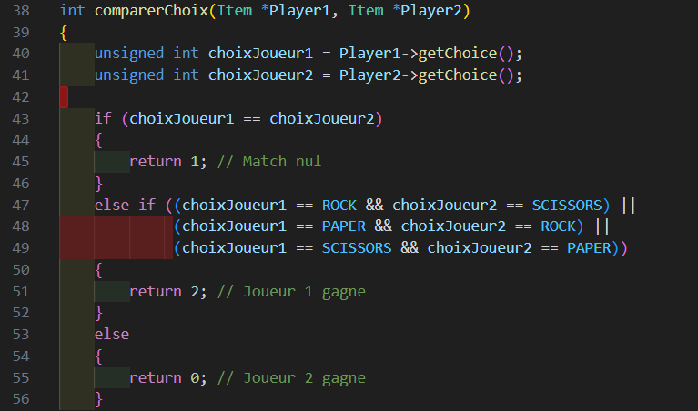
Compare the Players input
Get the choice of the Player and compare input

Slide 9
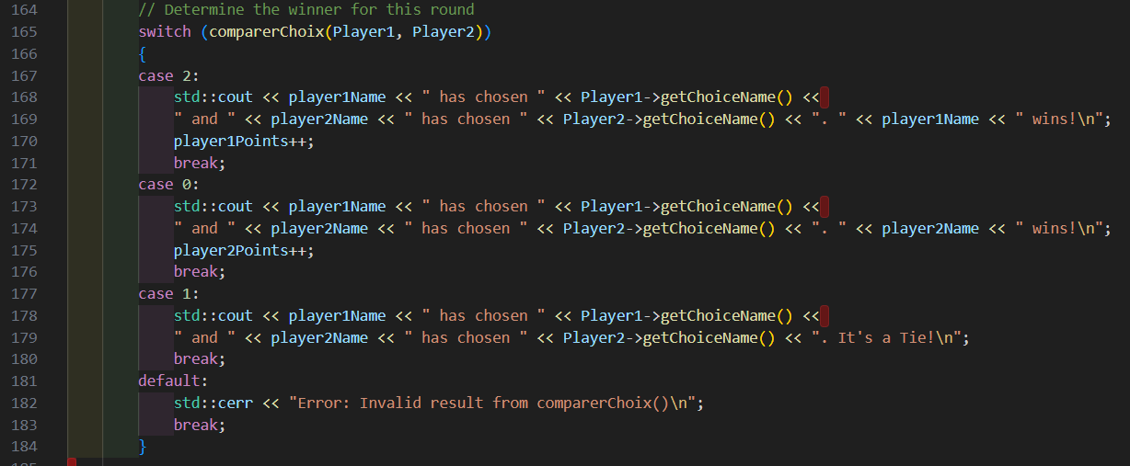
Print out the result

Slide 10
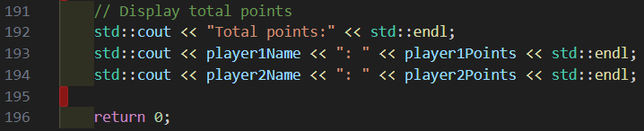
Print score in the end

Slide 11

Any questions ?

